Slide 1

Snakes & Ladders
Final Project
CMPE-160
Salman Ahmed, Dana Barhoom, Akbar Saleh, Waleed Alansari

Slide 2

Introduction
The development of game design using the C++ programming language is particularly important in the field of computer programming to demonstrate the language's comprehension. The lab project described below was completed to illustrate our team's understanding of the C++ programming language. The design process for the chosen game of snake and ladders will be highlighted in this article. It explains the game's working prototype. This article includes extensive descriptions of the coding associated with the design choices that describe the game's key parts. Furthermore, the article addresses the game's summary, and explains the gameplay.

Slide 3
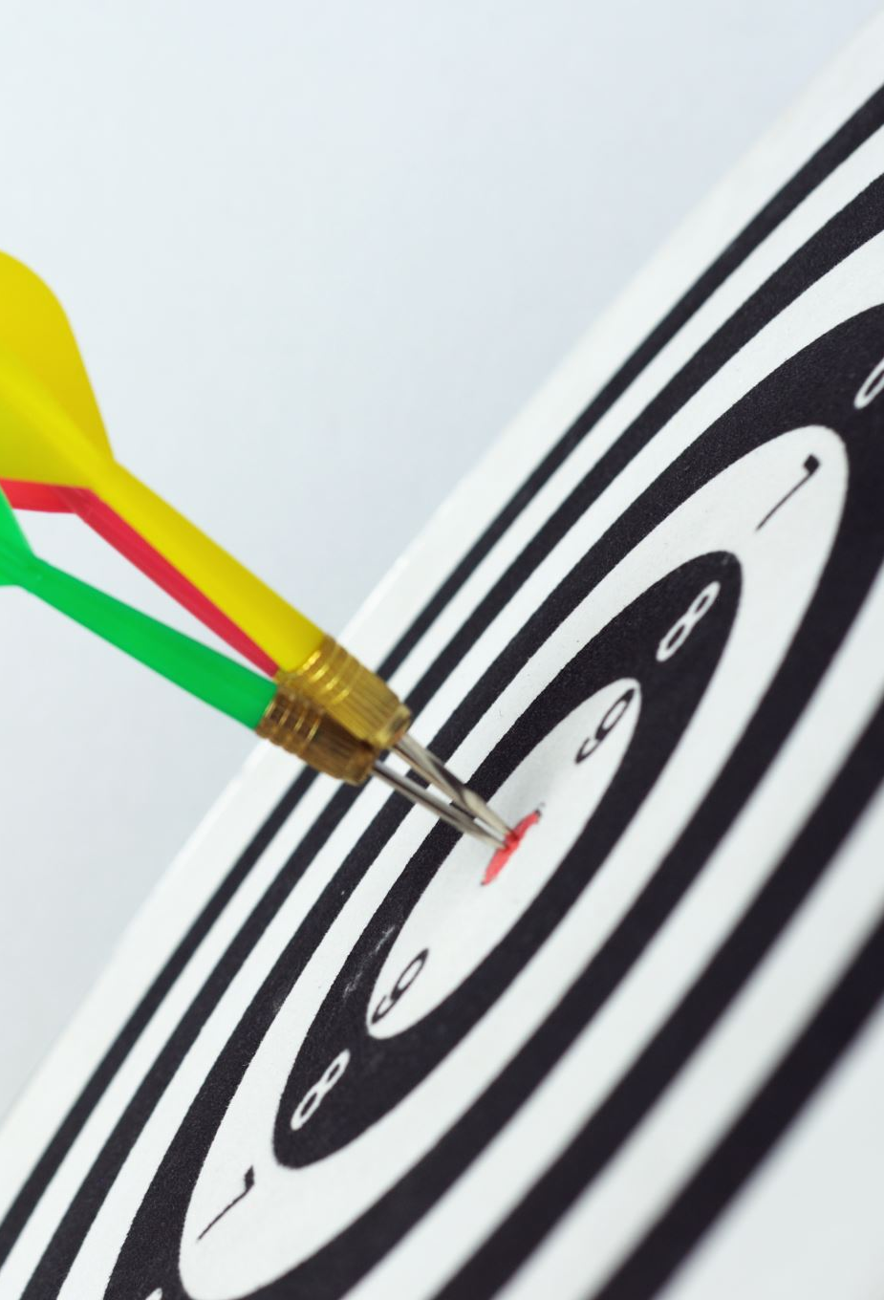
Objective
The main target of the game is to navigate one’s game piece from the first square towards the finish, which would be the last square. The player who reaches the last square first will be the winner.

Slide 4

Flow-chart For the Main-Menu
Quit
How to Play
Main Menu
Display "Program Ended"
Read the data from "Scores.txt" and display it (DisplayScores function)
Display to the user how to play (HowToPlay function)
End
This part is explained below in "Play Function (Part 1)"
Last Game Scores
Play
This part is explained below in "Play Function (Part 2)"

Slide 5
Teamwork First meeting minutes
Date | May 3, 2021
Topic | Developing a C++ program
Meeting start time | 4:00 pm
Name of the group | Snakes and Ladders group
Attendees (names, titles, and roles) | Akbar Saleh – A00163 Waleed Alansari – A00208 Salman Ahmed – A00143 Dana Barhoom – A00200
Absentees | None
Agenda | Discuss when each section is due Discuss the division of work and the plan.
Discussions and what the meeting has accomplished | The game agreed upon is Snakes and Ladders Division of work
Action plan (tasks, members responsibilities, deadlines) | Finish ½ of the coding process by 5th of May: Akbar, Waleed Starting with the skeleton of the report by 5th of May: Dana, Salman
Meeting end time | 5:00 pm
Meeting minutes recorder | Dana Barhoom

Slide 6
Second meeting minutes
American University of Bahrain (AUBH)
Date | May 5, 2021
Topic | Developing a C++ program
Meeting start time | 4:00 pm
Name of the group | Snakes and Ladders group
Attendees (names, titles, and roles) | Akbar Saleh – A00163 Waleed Alansari – A00208 Salman Ahmed – A00143 Dana Barhoom – A00200
Absentees | None
Agenda | Discuss when the rest of the sections are due Discuss what was accomplished so far.
Discussions and what the meeting has accomplished | Edited and enhanced the coding as a group Talked about completing the rest of the coding, excluding the coding parts related to the text files.
Action plan (tasks, members responsibilities, deadlines) | Finish the rest of the coding process by the 5th of May: All members' contribution. Report check and correction: Akbar
Meeting end time | 5:00 pm
Meeting minutes recorder | Dana Barhoom

Slide 7
Third meeting minutes
American University of Bahrain (AUBH)
Date | May 7, 2021
Topic | Developing a C++ program
Meeting start time | 4:00 pm
Name of the group | Snakes and Ladders group
Attendees (names, titles, and roles) | Akbar Saleh – A00163 Waleed Alansari – A00208 Salman Ahmed – A00143 Dana Barhoom – A00200
Absentees | None
Agenda | Discuss when the rest of the coding parts related to the text files, report, and presentation are due Discuss or edit what was accomplished so far
Discussions and what the meeting has accomplished | Discussed the coding process of the game Set dates to complete the coding parts related to the text files, report, and presentation.
Action plan (tasks, members responsibilities, deadlines) | Finish the text files coding parts: Akbar, Waleed Finalizing the report by 8th of May: Dana, Akbar Finish the presentation by 9th of May: Salman
Meeting end time | 5:00 pm
Meeting minutes recorder | Dana Barhoom

Slide 8

Main Code Functions

Slide 9
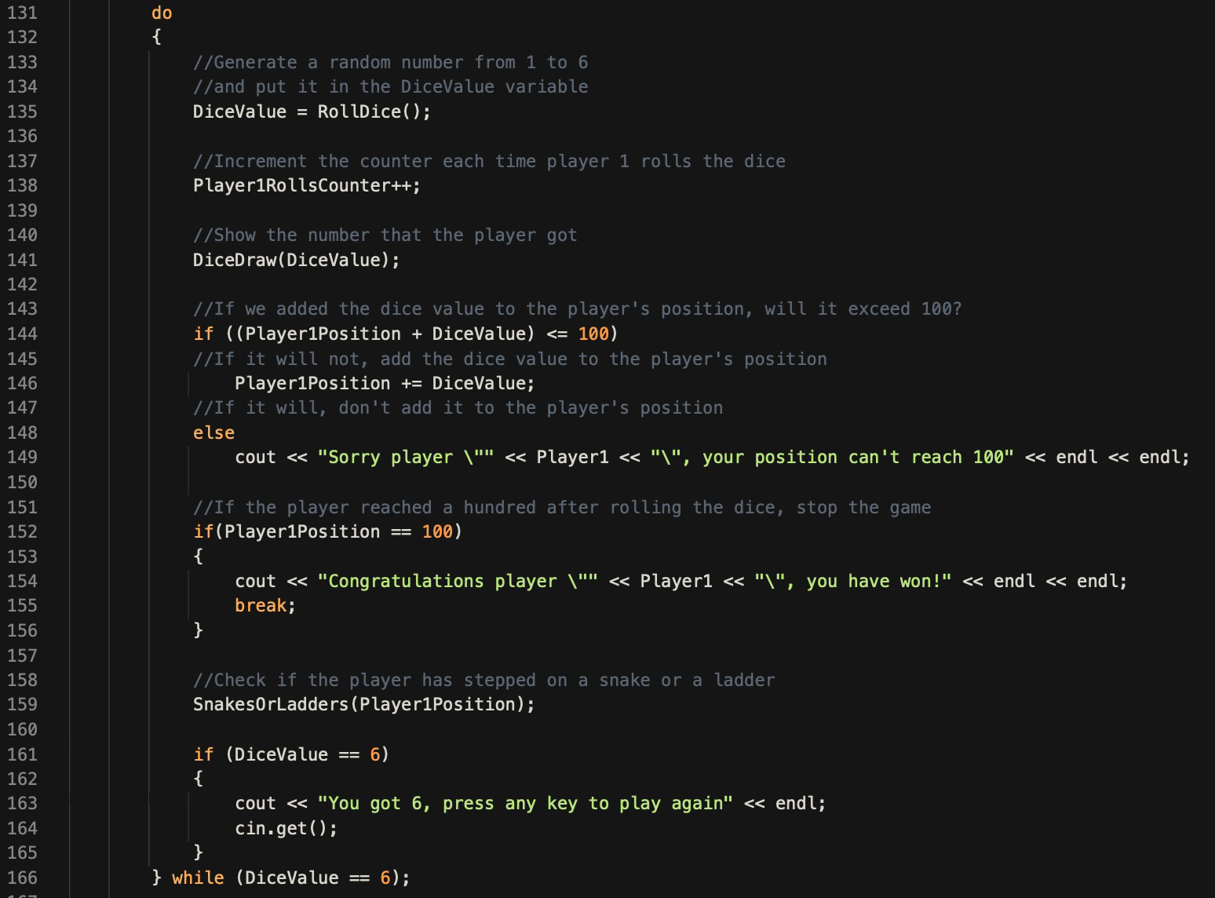
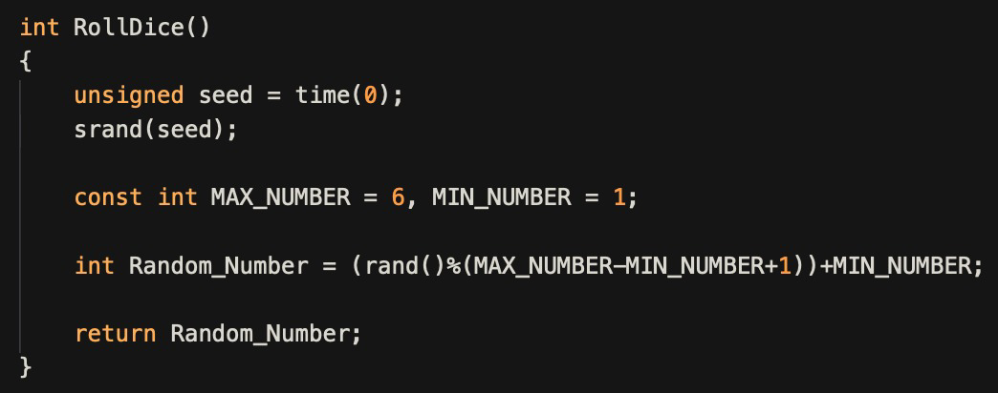
Functions
Play
RollDice

Slide 10
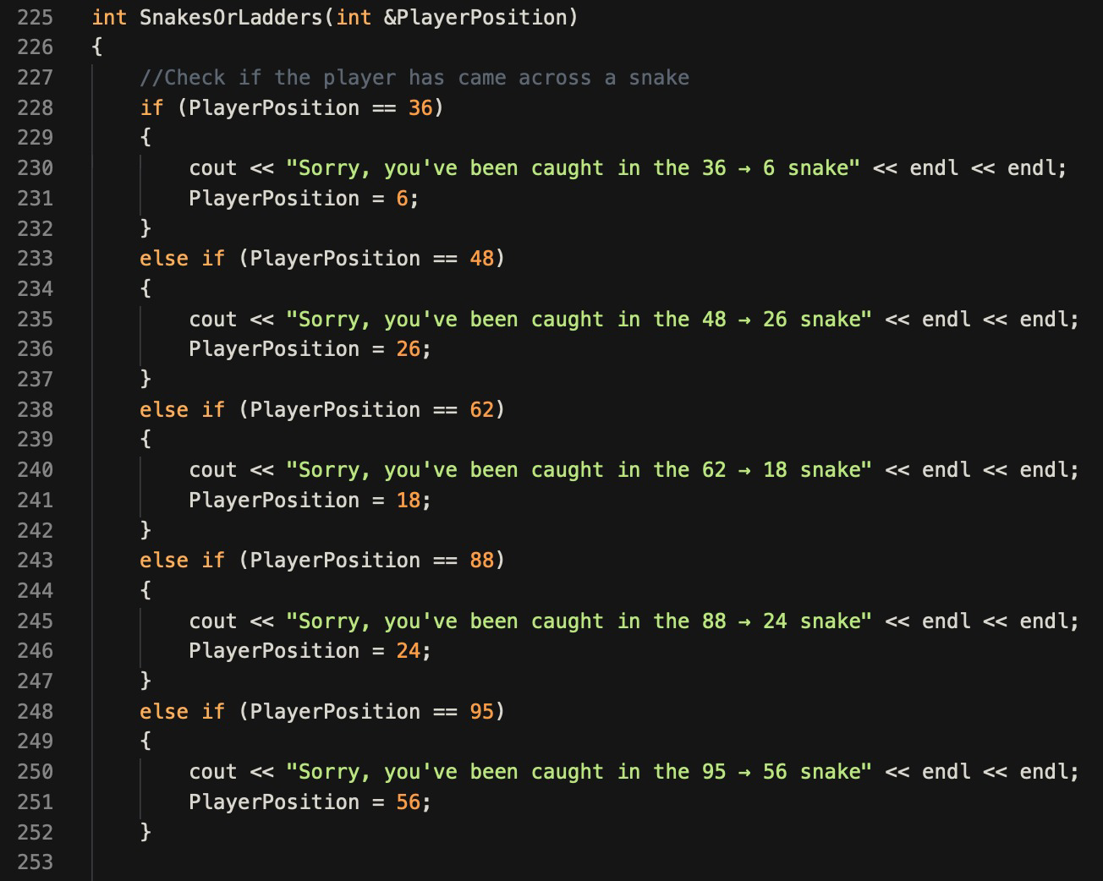
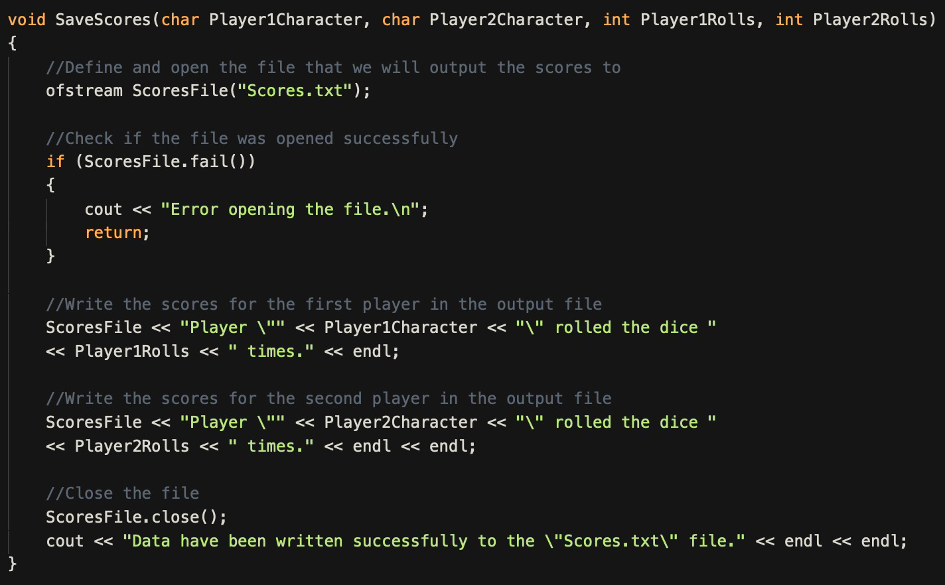
Functoins
SnakesOrLadders
SaveScores

Slide 11
Challeges we Faced
Because our code was long, it was hard to detect small issues that caused our program to not work properly. So, it was more difficult to debug the longer the code became.
Coming up with suitable variables names that convey what the variable does was hard as well, like we did some long variable names sometimes.
Trying to find a way to work with each other on the same code at the same time. Then we found a website that helped us do that.

